Slide 1
Office 365 Development

Slide 2

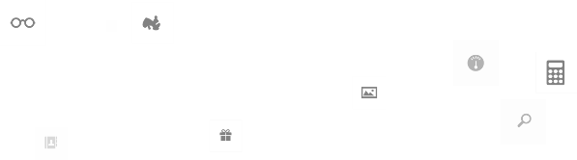

Recap
Introduction to Office 365 development
Module 1: Introduction to Office 365 development
Module 2: Getting started with Apps for Office
Module 3: Getting started with Apps for SharePoint
Module 4: Moving Full Trust Code to the Cloud Using Repeatable Patterns and Best Practices
Module 5: Getting started with the Office 365 APIs
dev.office.com/training

Slide 3
Course Agenda
Deep Dive into Integrating Office 365 APIs with Web Applications
Module 1: Deep Dive into Azure AD with the Office 365 APIs
Module 2: Deep Dive into Office 365 APIs for Calendar, Mail, and Contacts
Module 3: Deep Dive into Office 365 APIs for OneDrive for Business
Module 4: Deep Dive into Office 365 APIs for SharePoint Site services
Module 5: Deep Dive into Office 365 APIs for Yammer services
Module 6: Deep Dive into Office 365 APIs for Office Graph
Module 7: Deep Dive into Office 365 APIs for OneNote services

Slide 4
Deep Dive into Office 365 APIs for OneNote services

Slide 5

Agenda
Introduction
OneNote API Scenarios
Get Started with the OneNote service
Deep Dive into the OneNote service

Slide 6
Developer vision
USERS
DATA
HTML

Slide 7
Introduction

Slide 8
OneNote API Vision
Fast, simple, available anywhere
RESTful. Built on OData, JSON and HTML
CRUD API for Notes
Find anything quickly
Entity recognition, image processing, schematized content, and tags
Your digital memory store in the cloud
One place for all your memories. Never forget anything again.
Evoke your ideas whenever you need them with natural language search
Enable more personalized devices, apps, and smarter digital assistants
Notes:
This slide presents the overall vision for the OneNote product/service

Slide 9
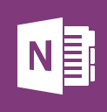
Pre-installed on every new Windows Device
Free on all platforms
Windows 8.1
Windows Phone
Mac
iOS
Android
And on the web with OneNote Online
New 1st party capture experiences
Office Lens for WP: Your pocket scanner. Fixes, enhances, and makes pictures readable
OneNote Clipper: Clip the web using your favorite browser
me@onenote.com: Email and save to OneNote
100+ million users
15 GB of free storage with OneDrive
Notes:
Facts and figures about OneNote

Slide 10
OneNote API Scenarios

Slide 11
OneNote API Scenarios
Create Pages and Sections
Simple Captures – lightweight HTML
Structured HTML – paragraphs, tables, images
Capture to specific section
Capture photos and images
Reference to an <img> on the internet
Include binary image data
Capture web page snapshot
Provide URL of page – stored as image
Provide HTML – stored as image

Slide 12
OneNote API Scenarios
Capture embedded files
Specify filename and Mime type
Include binary data
Rendered as icon and opens in native application (based on Mime type)
Capture PDF
Embed PDF file
Also display each page as an image

Slide 13
OneNote API Scenarios
Pages
Query List
Recall Page Content
Page Updates
Future Scenarios
Embeddable pages
Copying
Sharing
See Dev Center and Dev Blog:
http://dev.onenote.com
http://blogs.msdn.com/b/onenotedev/

Slide 14
Which Scenario?
Do you require editable content or just an image?
Content is “local” or at some URL?
Content is accessible by OneNote service, or requires authentication?

Slide 15
Getting Started with the OneNote Service

Slide 16
One-Click capture
“Clipper” – Favorite button for IE on Desktop
www.onenote.com
OneNote save dialog
JavaScript snippet
Notes:
var href = "https://www.onenote.com/clipper/save" + "?sourceUrl=" + url + "&imgUrl=" + imgUrl + "&title=" + title + "&description=" + description + "&notes=" + notes;

Slide 17
demo
One-Click Capture to OneNote
Notes:
OneNote Clipper: https://www.onenote.com/Clipper/OneNote
Demos\OneNoteSaveDialog folder: The html page contains two links for the Save Dialog. The first will capture a page from MSDN. The second uses jQuery to dynamically set the page to capture to be the current page. Running the page from http://localhost will cause the capture to omit the picture of the page. This is because the OneNote service cannot access localhost. This is an important distinction that will be discussed later in the module.

Slide 18
Getting Started with custom application
Register your app
Authenticate the user
Capture Content
Add to OneNote Service
Notes:
Documentation http://dev.onenote.com/

Slide 19
Register with Microsoft Live Service
OneNote API uses OneDrive – requires Live Service
https://account.live.com/developers/applications/create
Requires Microsoft Account
OneNote API uses OneDrive for Business – requires O365
Requires Microsoft Account
If you’re developing… | You’ll need to have a … | So you can get your…
Android, iOS or Windows Phone | Microsoft Account | Client ID
Windows Store apps | Microsoft Account registered as a Windows Store developer account | Package Identity
Other types (Win7/Web/Desktop) | Microsoft Account | Client ID, client secret, redirect domain
Notes:
http://go.microsoft.com/fwlink/?LinkId=193157
http://msdn.microsoft.com/en-us/library/ff751474.aspx

Slide 20
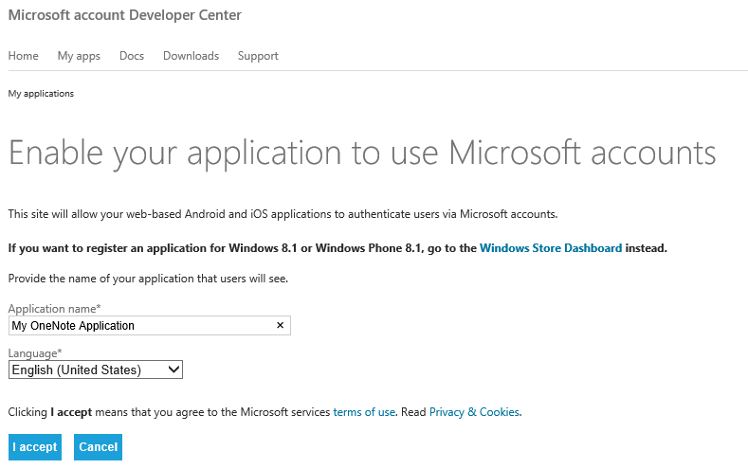
OneDrive Consumer - Register Application

Slide 21
Authenticate the User
Live SDK
Available via NuGet
Microsoft.Live.LiveAuthClient class
Manages Access / Refresh tokens
Scope
Office.OneNote_Create, Office.OneNote_Update, Office.OneNote_Update_By_App, Office.OneNote
(WL.SignIn & WL.Offline_Access required for using Refresh Token)
Permission Scope reference documentation on MSDN

Slide 22
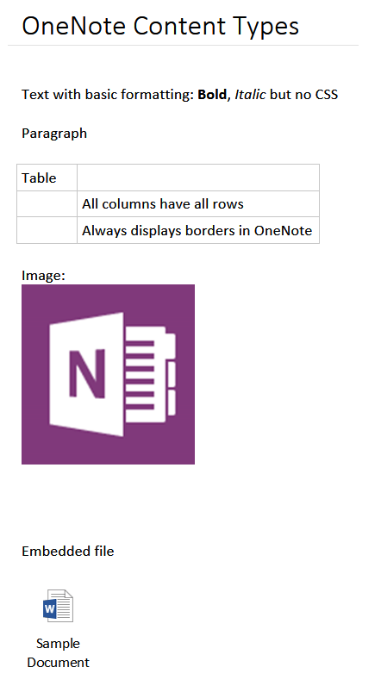
Capture Content
HTML
Image
Embedded File

Slide 23
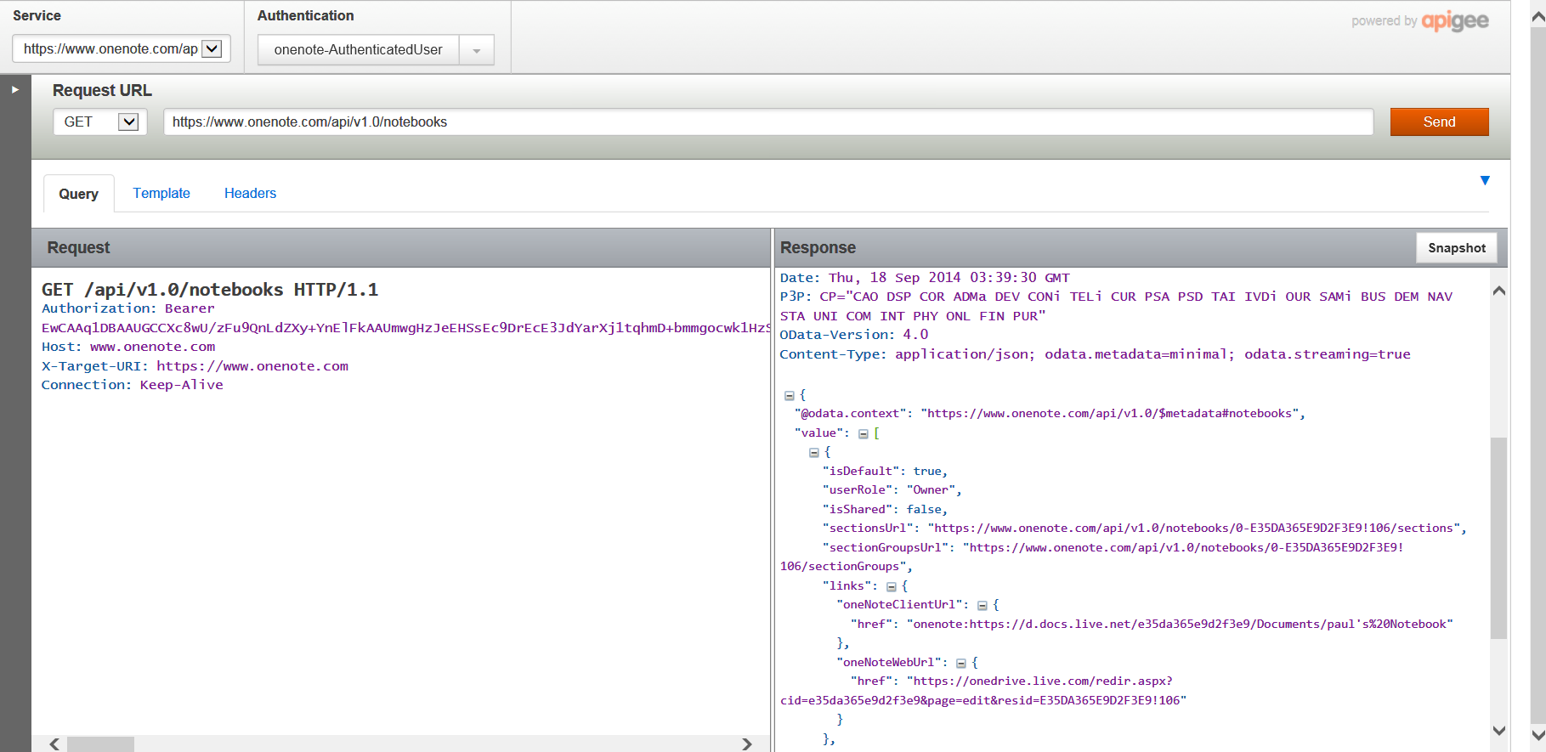
Add to OneNote
RESTful API
http://dev.onenote.com/
OAuth token in header
Content in POST body
UTF-8 encoding
HTML must be well-formed
Try it out
https://apigee.com/onenote/embed/console/onenote/ (production)
https://apigee.com/onenote_beta/embed/console/onenote_beta/ (bleeding edge, beta)

Slide 24
OneNote REST Interface
GET
Pages
Sections
SectionGroups
Notebooks
POST
Pages
Sections
Notebooks
PATCH (Beta)
Pages
Root URI
https://www.onenote.com/api/v1.0/
Beta URI
https://www.onenote.com/beta/

Slide 25
Using OneNote API with Office 365
Notebooks stored in a user’s OneDrive for Business are accessible via OneNote API
Register application with Azure AD
OneNote specific permissions & scopes available
Authenticate with Azure AD & obtain access token
Requires you to first login to OneNote.com with your Office 365 account to get OneNote permission & scope to appear in Azure AD

Slide 26
demo
Explore the REST API using apigee
Notes:
https://apigee.com/onenote/embed/console/onenote/

Slide 27
Content Capture in Depth

Slide 28
Capture Text
var client = new HttpClient(); client.DefaultRequestHeaders.Accept.Add(new MediaTypeWithQualityHeaderValue("application/json")); client.DefaultRequestHeaders.Authorization = new AuthenticationHeaderValue("Bearer", _authClient.Session.AccessToken); string simpleHtml = "<html><head>" + "<title>A simple page created from basic HTML-formatted text on Windows 8</title>" + "<meta name=\"created\" content=\"" + DateTime.Now.ToString("o") + "\" /></head>" + "<body><p>This is a page that contains some simple <i>formatted</i> <b>text</b></p>" + "<p>Here is a <a href=\"http://www.microsoft.com\">link</a></p></body></html>"; var endPoint = new Uri("https://www.onenote.com/api/v1.0/pages"); var createMessage = new HttpRequestMessage(HttpMethod.Post, endPoint) { Content = new StringContent(simpleHtml, System.Text.Encoding.UTF8, "text/html") }; HttpResponseMessage response = await client.SendAsync(createMessage);
Notes:
This snippet represents a simple text capture.
In addition, it provides the basic structure that the following snippets will build upon:
Create an HttpClient
Set the Headers
Build the content for the to-be-created page
Post to the endpoint

Slide 29
Capture Image
var client = new HttpClient(); // [set Accept and Authorization headers as previous example] string simpleHtml = // [similar to previous example] "<img src=\"name:image1\" width=\"426\" height=\"68\" />" using (var imageContent = new StreamContent(await GetBinaryStream("assets\\Logo.jpg"))) { imageContent.Headers.ContentType = new MediaTypeHeaderValue("image/jpeg"); var endPoint = new Uri("https://www.onenote.com/api/v1.0/pages"); var createMessage = new HttpRequestMessage(HttpMethod.Post, endPoint) createMessage.Content = new MultipartFormDataContent { {new StringContent(simpleHtml, System.Text.Encoding.UTF8, "text/html"), "Presentation"}, {imageContent, "image1" } }; }; HttpResponseMessage response = await client.SendAsync(createMessage);
Notes:
Capturing an image requires MultipartFormDataContent. The “src” attribute of the<img> tag has a specific protocol and value.
The protocol “name:” indicates the image is contained in another part of the Form Data with the given name (“image1” in this example).
Point out the names of the content in the MultipartFormDataContent. The string content (the html) is named “Presentation” and the image bytes are named the same as the value in the src attribute of the <img> tag.
The name “Presentation” is required – indicates the main part of the capture.

Slide 30
Capture Web Page Snapshot
var client = new HttpClient(); // [set Accept and Authorization headers as previous example] string simpleHtml = // [similar to previous example] "<img data-render-src=\"http://www.onenote.com\" />" var endPoint = new Uri("https://www.onenote.com/api/v1.0/pages"); var createMessage = new HttpRequestMessage(HttpMethod.Post, endPoint) { Content = new StringContent(simpleHtml, System.Text.Encoding.UTF8, "text/html") }; HttpResponseMessage response = await client.SendAsync(createMessage);

Slide 31
Capture Web Page Snapshot
<img data-render-src="http://.onenote.com" ... />
The URL can be either a web page or an image
Must be publicly available without a password.
<img data-render-src="name:MultiPartBlockName" ... />
The content-type of that named block controls the API handling of content.
A block of HTML to render in a browser (content-type=text/html)
An image (content-type=image/jpeg or similar).
The HTML rendering engine used to create the image has no ability to log in a user, and does not include plug-ins (Adobe Flash, Apple QuickTime, etc.).
Dynamically-loaded content, (AJAX), won't appear credentials or cookies are required.
Notes:
The first method is great for archiving things you see on web sites that change frequently.
The second method is useful when the web page is more-complex than the OneNote page can faithfully render, or when the page requires login credentials. It is important to know that the HTML in the non-presentation block cannot use the data-render-src attribute.

Slide 32
Capture Embedded File
var client = new HttpClient();// [set Accept and Authorization headers as previous example] string simpleHtml = // [similar to previous example] "<object data=\"name:file1\" data-attachment=\"file1.docx\" type=\"application/vnd.openxmlformats-officedocument.wordprocessingml.document\" />" using (var fileContent = new StreamContent(await GetBinaryStream("assets\\file1.docx"))) { fileContent.Headers.ContentType = new MediaTypeHeaderValue( "application/vnd.openxmlformats-officedocument.wordprocessingml.document"); var endPoint = new Uri("https://www.onenote.com/api/v1.0/pages"); var createMessage = new HttpRequestMessage(HttpMethod.Post, endPoint) createMessage.Content = new MultipartFormDataContent { {new StringContent(simpleHtml, System.Text.Encoding.UTF8, "text/html"), "Presentation"}, {fileContent, "file1" } }; }; HttpResponseMessage response = await client.SendAsync(createMessage);

Slide 33
Capture PDF
var client = new HttpClient();// [set Accept and Authorization headers as previous example] string simpleHtml = // [include both <object> and <img>] "<object data=\"name:pdf\" data-attachment=\"file1.pdf\" type=\"application/pdf\" />“ "<img src=\"name:pdf\" />" using (var pdfContent = new StreamContent(await GetBinaryStream("assets\\file1.pdf"))) { fileContent.Headers.ContentType = new MediaTypeHeaderValue("application/pdf"); var endPoint = new Uri("https://www.onenote.com/api/v1.0/pages"); var createMessage = new HttpRequestMessage(HttpMethod.Post, endPoint) createMessage.Content = new MultipartFormDataContent { {new StringContent(simpleHtml, System.Text.Encoding.UTF8, "text/html"), "Presentation"}, {pdfContent, "pdf" } }; }; HttpResponseMessage response = await client.SendAsync(createMessage);

Slide 34
demo
Creating Content from Windows Store App
Notes:
Demos\OneNoteAPISampleWinStore folder:
Check authentication status in upper right. Click Authenticate if necessary. In the flyout, click Account
In left navigation, select a scenario.
In center, enter a section name. If it does not exist, it will be created.
Click the Create Page button to create the page. Review Response and link boxes.
** Do not click “Step through create page code” button at this time. **
After running a few scenarios, return to the slides to explain the steps.

Slide 35
Key Links
OneNote
https://www.onenote.com
OneNote Dev Center
http://dev.onenote.com
OneNote Dev Blog
http://blogs.msdn.com/b/onenotedev/
App Registration
http://msdn.microsoft.com/en-us/library/ff751474.aspx
API Playground
https://apigee.com/onenote/embed/console/onenote
https://apigee.com/onenote_beta/embed/console/onenote_beta

Slide 36
Related Documentation
OneNote Dev Center
http://dev.onenote.com
API Reference
http://dev.onenote.com/docs
JavaScript API for Office
https://msdn.microsoft.com/en-us/library/fp142185.aspx

Slide 37
Related Code Samples
OneNote Dev on GitHub
https://github.com/OneNoteDev

Slide 38
Summary
Introduction
OneNote API Scenarios
Get Started with the OneNote service
Deep Dive into the OneNote service

Slide 39
Developer Program Launch
1 YEAR FREE
E-mail Newsletters
Free Developer Subscription
Free Training
Free Tools
Webinars
http://dev.office.com/devprogram

Slide 40


Engage
Office 365 Network
https://www.yammer.com/itpronetwork
Twitter
S
S
t
t
a
a
r
r
t
t
@OfficeDev
Stack overflow
[ms-office]
Channel 9 Dev Show
http://aka.ms/O365DevShow
Podcasts http://dev.office.com/podcasts
Snack Demos
http://aka.ms/o365DevSnackDemos
UserVoice
http://officespdev.uservoice.com/

